Slide 1

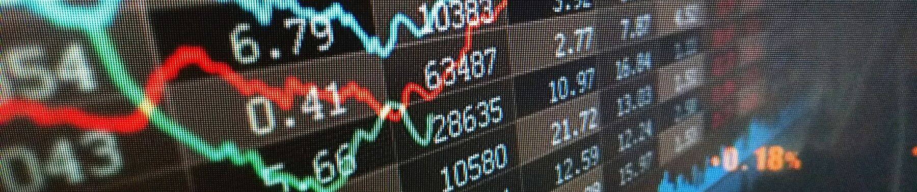
TIME SERIES Forecasting OF APPLE STOCK PRICE
By Killian Vervelle and Antony Carrard
v

Slide 2
Summary
Forecasting
Data
Explanatory data analysis
Modeling
Prediction and comparison
Questions, references
Notes:
Forecasting is the process of making predictions of the future based on past and present data!
It is also very hard since none has the correct model of the world.
Explaining a particular kind of prediction is equally important, since you can make a more compelling case out of it.
It is also very hard since none has the correct model of the world.
Explaining a particular kind of prediction is equally important, since you can make a more compelling case out of it.

Slide 3
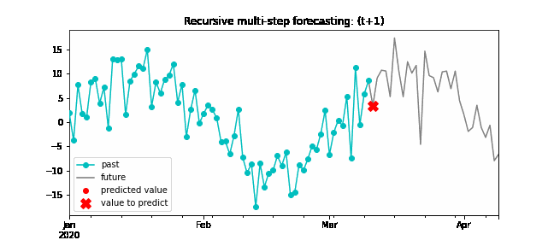
forecasting
Notes:
Forecasting is the process of making predictions of the future based on past and present data!
It is also very hard since none has the correct model of the world.
Explaining a particular kind of prediction is equally important, since you can make a more compelling case out of it.
It is also very hard since none has the correct model of the world.
Explaining a particular kind of prediction is equally important, since you can make a more compelling case out of it.
Are causal relationships necessary for forecasting?
Not necessarily!
A lot of times, the past observations of certain variables are the best forecasters of future observations.
Can we just use anything?
Not necessarily, since there are a lot of spurious co-movements.
What to do?
Strike a balance!
Good models are the ones that capture time series properties of the data, as well as adhere to some economic theory.

Slide 4

Data
Data extracted from
Stock Prices from February 2008 (subprime crash) to March 2020 (voluntarily excluding Covid)
Excluded weekly/monthly time segmentation (major loss of information, explanation will follow)

Slide 5
Exploratory Data Analysis
Apple gov change (unit sales data)
Apple 7-1 stock split 2014
Steve Jobs quits Apple – stock dgrd 2011
Subprimes 2007-2010

Slide 6
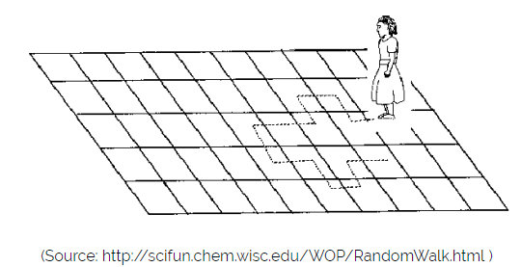
Exploratory Data Analysis
Apple (AAPL) Daily Stock Prices
Random Walk
X(t) = X(t-1) + Er(t)
ADF test for stationariy:
p_value = 0.997
Notes:
There is, therefore, no sequential dependence or learnable structure to be found in the data.
Period Covid confirme la random walk

Slide 7
Exploratory Data Analysis
Auto-Correlation and Partial Auto-Correlation
Notes:
The autocorrelations are positive for many number of lags (10), so the series needs further differencing. The stock return (difference between opening and closing stock price) might provide the mean to reach stationarity.

Slide 8
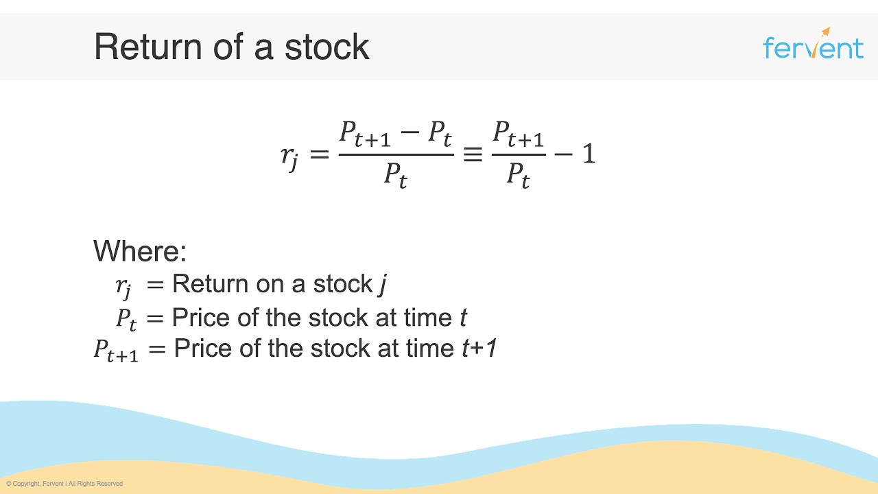
Exploratory Data Analysis
Stationarity – 1st order of differencing (returns)
p_value (ADF) = 1.068e-29
Notes:
The ARMA models combines the AR models and the MA models. The ARMA(p,q) contains the AR(p) and the MA(q) and can be used for univariate time series. The main assumption in time series analysis is that the time series is stationary and this is not the case for many pratical situations. The solution to this can be found in the Autoregressive Integrated Moving Average(ARIMA) model. The ARIMA (p,d,q) introduces the possibility to apply differencing to the data d times in order to make it stationary. After the differenciation, the model becomes ARMA(p,q). ARIMA is a natural extension to the class of ARMA models — they can reduce a non-stationary series to a stationary series using a sequence of differences. ARIMA model has 3 parameters: P — Auto regressive feature of the model (number of lags of Y to be used as predictors) D — Differencing order (minimum number of differencing needed to make the series stationary) Q — Moving average feature of the model (number of lagged forecast errors that should go into the ARIMA Model)

Slide 9
Exploratory Data Analysis
Auto-Correlation and Partial Auto-Correlation
Notes:
Firstly, we notice than smoothing the signal by taking a weekly or monthly timescale does not help in improving the correlograms.
Then we notice that the ACF and the PACF cut off at lag 1.
We also notice that on lag 4, we have a strong signal on the PACF (representing the AR part of an ARMA model) which could be due to the fact that the stock market is open 5 days a week.
The first order differencing seems to have made the data stationary.

Slide 10
Modeling
ARIMA
Finding the AR term (p) => PACF
Finding the MA term (q) => ACF
Finding the differencing order
Final model: ARIMA (1,1,1)
===================================================
coef std err z P>|z| [0.025 0.975]
--------------------------------------------------------------------------------------
ar.L1 -0.8304 0.115 -7.240 0.000 -1.055 -0.606
ma.L1 0.8472 0.109 7.758 0.000 0.633 1.061
sigma2 0.1987 0.002 92.556 0.000 0.194 0.203
Notes:
The next step is to identify if the model needs any AR terms. You can find out the required number of AR terms by inspecting the Partial Autocorrelation (PACF) plot. The PACF plot has a significant spike at lag 1 and 4, meaning that all the higher-order autocorrelations are effectively explained by these lags. We will be conservative and take a p = 1 to start with and then compute again with a p = 4.
To find this parameter, we can simply take a look at the ACF for the number of MA terms. The ACF tells how many MA terms are required to remove any autocorrelation in the stationarized series. The ACF cuts off at lag 1 and 4, so we will take q = 1 and then q = 4.

Slide 11
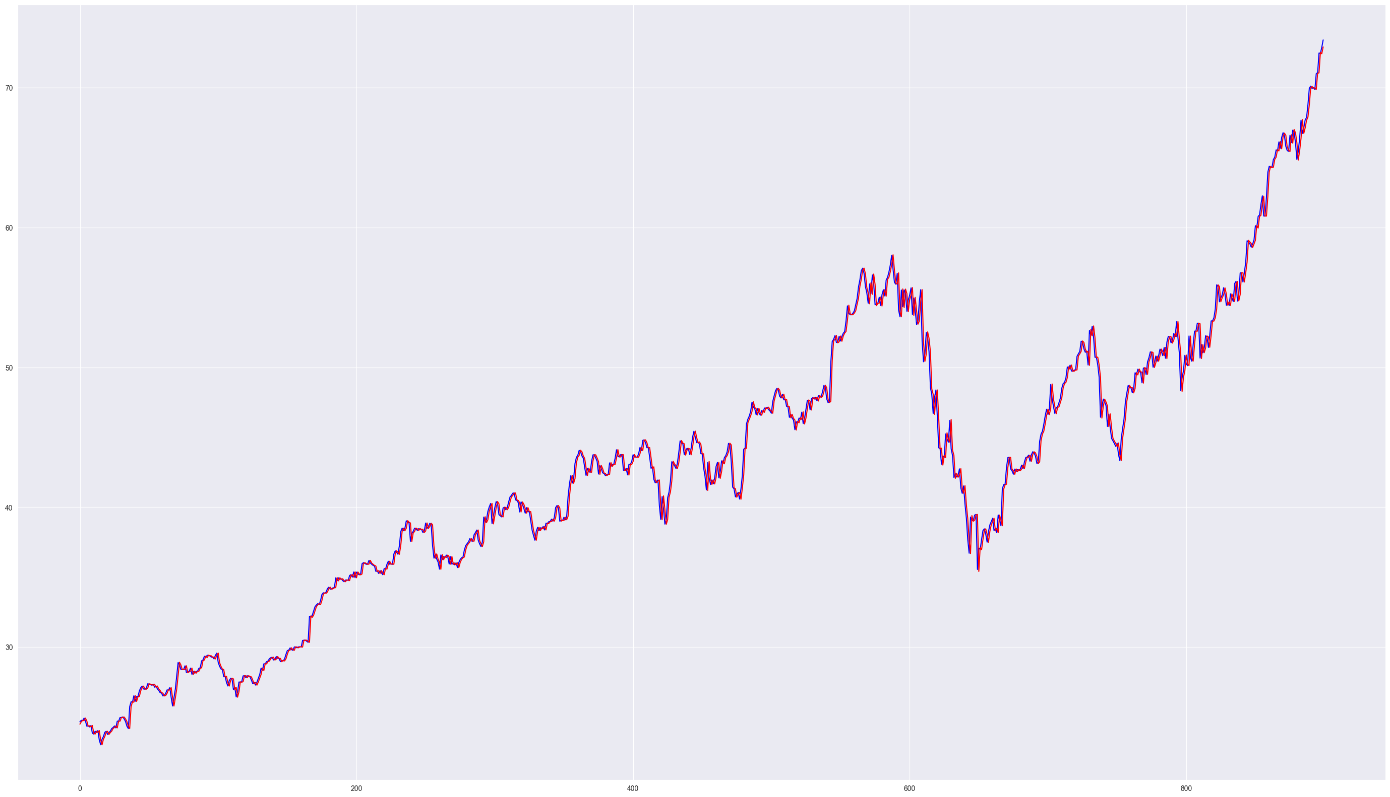

Modeling
ARIMA – Predictive performance
Mean Absolute Percentage error: 0.010
Notes:
The ARIMA (1,1,1) found previously seems to produce good predictive results with no lag in the signal. All coefficients are over the significance threshold and the MSE is very low. As for the ARIMA(4,1,4), the results are quite similar but the computing cost is much higher.
So, we seem to have a decent ARIMA model. But is that the best? We need to dig further to draw relevant conclusions that is to predict the future. In the next section, a bot will be trained to take decisions based on the ARIMA's (1,1,1) predicted return values, to buy or sell stock shares with hope to make a profit ! we will also try a simpler model AR(1).

Slide 12
Modeling
Auto-ARIMA
Stepwise search to minimize AIC (max_p=4, max_q=4)
ARIMA(1,1,1)(0,0,0)[0] intercept : AIC=3665.185
ARIMA(0,1,0)(0,0,0)[0] intercept : AIC=3663.899
ARIMA(1,1,0)(0,0,0)[0] intercept : AIC=3665.509
ARIMA(0,1,1)(0,0,0)[0] intercept : AIC=3665.467
ARIMA(0,1,0)(0,0,0)[0] : AIC=3669.806
Notes:
The correlogram of residuals is flat which is ideal meaning that the residual erros are not autocorrelated (residuals in a time serie is what is left over after fitting a model).
The density plot suggest normal distribution with mean zero. Overall, this model seems like a good fit.
Let’s move on to the next step, setting up the stock bot and comparing its financial performance based on different ARIMA / AR models.

Slide 13
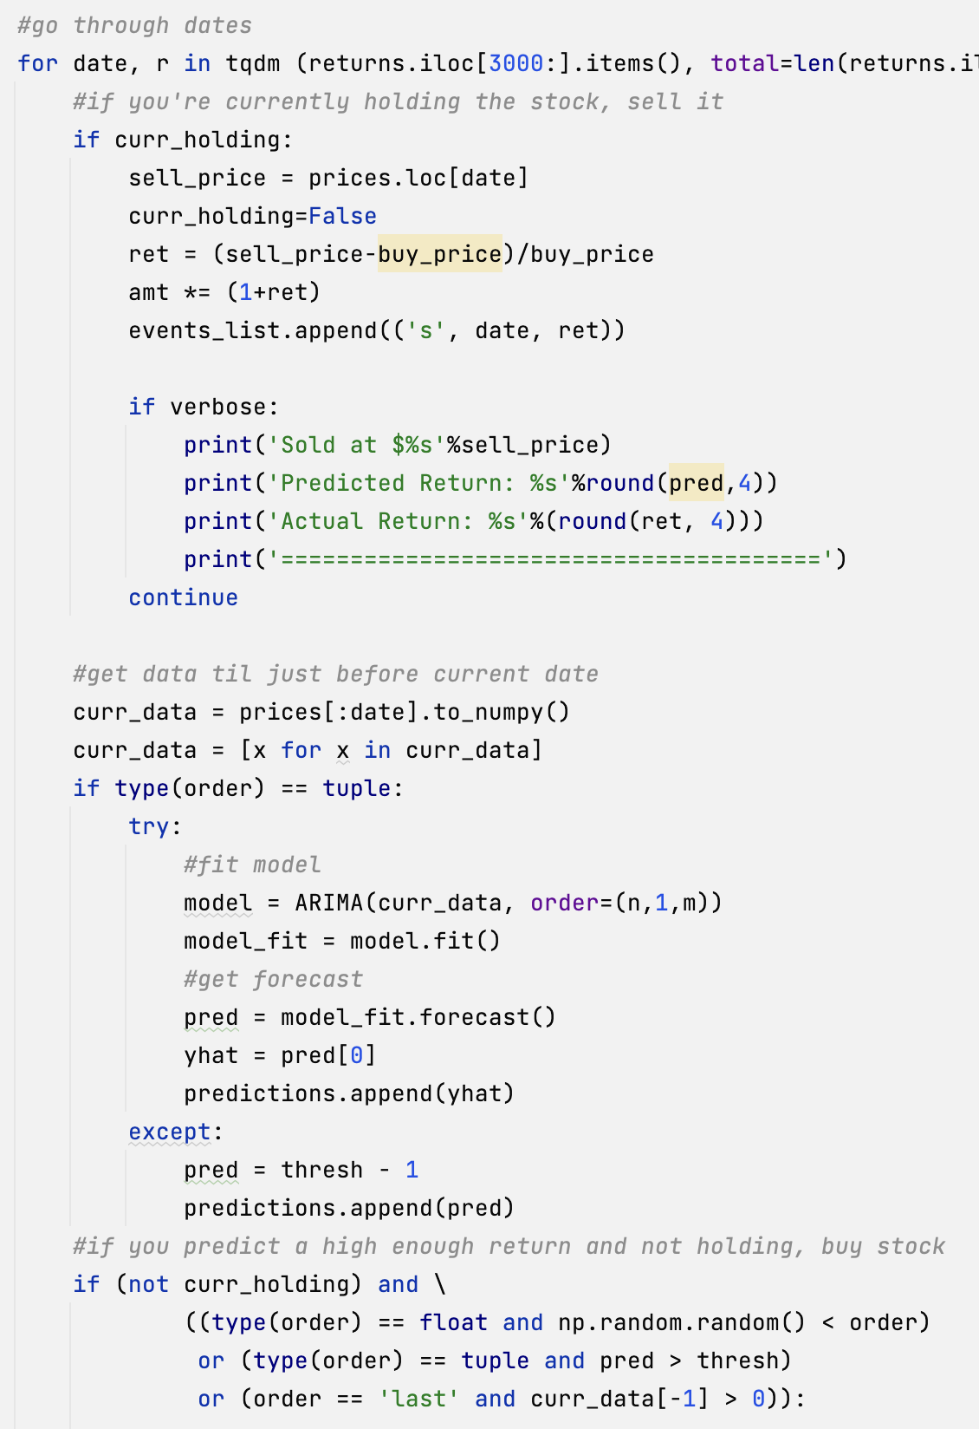
PREDICTION BOT
Random buying (avg performance – 50 runs)
Notes:
The bot didn't do well with a random buying model. In fact, we lost money of our initial investment of 100 dollars. In addition, the high variability (SD of 20) represents too much risk from a business perspective.

Slide 14
PREDICTION BOT
ARIMA (1,1,1)
Notes:
Success ! We managed to make a profit of our initial investment. The model seems to produce good results. However, this is cruelly misleading as any unexpected variations in the signal (such as covid) would severally impede the model's performance.
PA à investor ? Non malheureusement, fonctionnemnt degrade sur une volatilité plus importante
Forecasting Apple's stock value can be improved by: - Constantly updating model parameters (costly to compute) - Inputting additional economical factors that impact stock values and their correlations into account (harder to compute) - Model parameters can also be updated via machine learning and optimisation techniques (next step of this study)
Financial markets can move in any direction and this makes it very hard, if not impossible, to accurately predict exchange rates. Having said that, the sole purpose of forecasting exchange rates via ARIMA is to help us in taking calculated decisions that maximise returns and minimise risks. Forecasted exchange rates are dependent on the assumptions imposed by ARIMA model which are based on auto regression, integrated and moving average concepts. ARIMA is a simple yet powerful model. It assumes that the historic values dictate behaviour of present. It also assumes that the data does not contain anomalies, is stationary and model parameters along with error term is constant. Although ARIMA does not take stresses in market data as input (which are complexe and difficult to conceptualize) such as economical downturns and disruptives political changes, or correlations of all risk factors to forecast stock markets but the simple example demonstrated above can be useful for forecasting stable stocks in normal conditions in which past behaviour dictates present and future values.

Slide 15
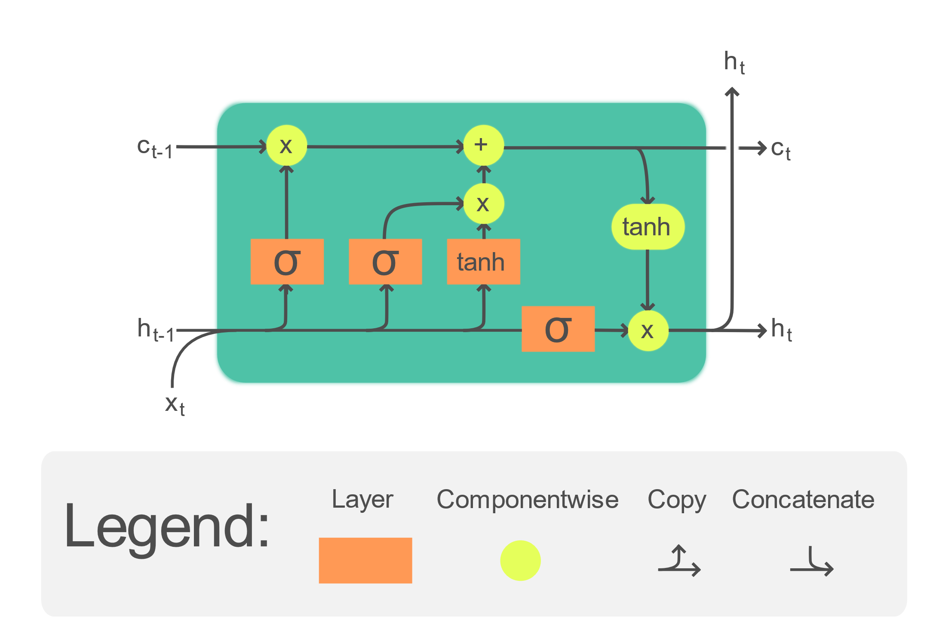
LSTM
https://en.wikipedia.org/wiki/Long_short-term_memory
Notes:
LSTM, ou Long short-term memory, est un réseau de neurones recurrent dote d’une mémoire, capable d’apprendre à prédire des sequences de donneés de tailles variables.
L’idée est que le modèle, composé de cellules, soit capable de mémoriser les comportements principaux de la série temporelle, et d’en oublier les comportements négligeables. Ce comportement est précieux lors de la prediction de valeurs boursières, car le modèle va pouvoir se rappeler des comportements du système sur le long terme et pouvoir ainsi plus facilement prédire le futur de l’indice, tant que le signal possède toujours un comportement semblable.

Slide 16
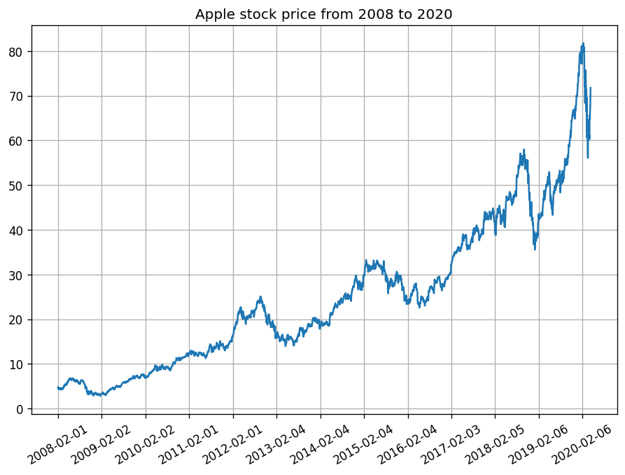
Data preprocessing
Notes:
Bien que le modèle LSTM ne nécessite pas d’avoir un signal stationnaire pour effectuer des prédictions, il est tout de même préférable de le faire car cela simplifie le signal et facilite la prédiction du modèle. Nous avons ainsi, comme pour l’ARIMA, effectué l’apprentissage du modèle sur un signal stationnaire. Nous avons également mis notre signal à l’échelle entre 1 et -1.
En effet, comme les fonctions d’activations des cellules LSTM sont des arc tangentes, il est préférable d’avoir un signal compris entre 1 et -1, car ces fonctions d’activations émettent une valeur de la même échelle.

Slide 17
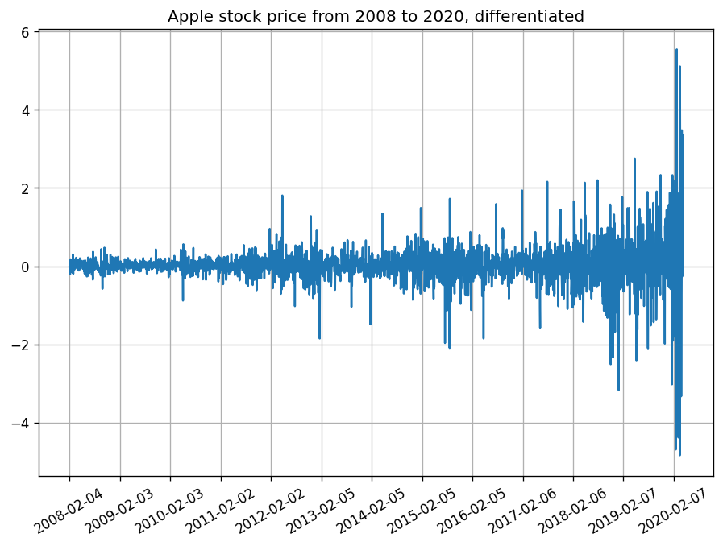
Data preprocessing
Notes:
Bien que le modèle LSTM ne nécessite pas d’avoir un signal stationnaire pour effectuer des prédictions, il est tout de même préférable de le faire car cela simplifie le signal et facilite la prédiction du modèle. Nous avons ainsi, comme pour l’ARIMA, effectué l’apprentissage du modèle sur un signal stationnaire. Nous avons également mis notre signal à l’échelle entre 1 et -1.
En effet, comme les fonctions d’activations des cellules LSTM sont des arc tangentes, il est préférable d’avoir un signal compris entre 1 et -1, car ces fonctions d’activations émettent une valeur de la même échelle.

Slide 18
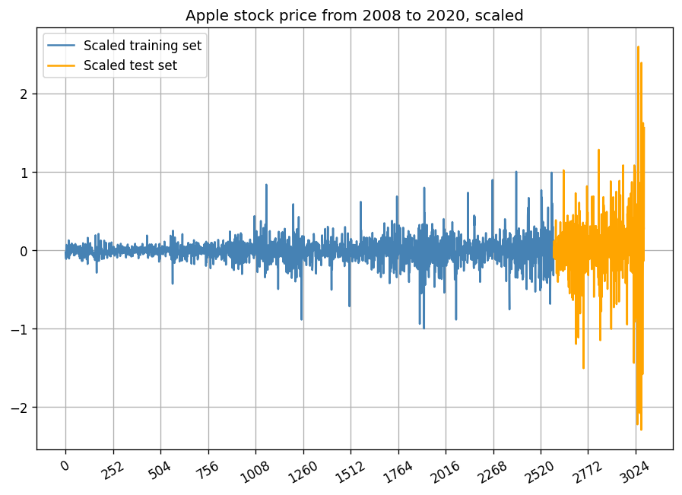
Data preprocessing
Notes:
Bien que le modèle LSTM ne nécessite pas d’avoir un signal stationnaire pour effectuer des prédictions, il est tout de même préférable de le faire car cela simplifie le signal et facilite la prédiction du modèle. Nous avons ainsi, comme pour l’ARIMA, effectué l’apprentissage du modèle sur un signal stationnaire. Nous avons également mis notre signal à l’échelle entre 1 et -1.
En effet, comme les fonctions d’activations des cellules LSTM sont des arc tangentes, il est préférable d’avoir un signal compris entre 1 et -1, car ces fonctions d’activations émettent une valeur de la même échelle.

Slide 19
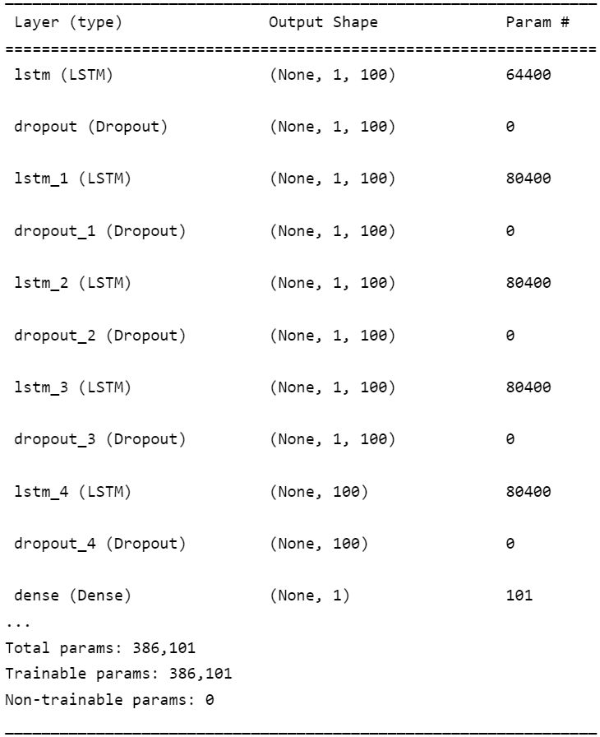
Neural network

Slide 20
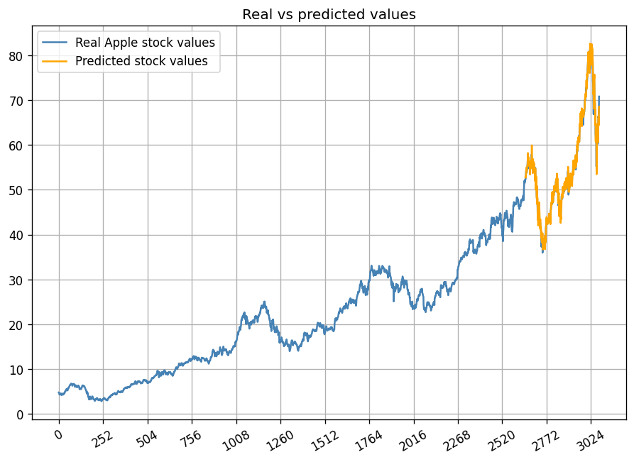
Results

Slide 21
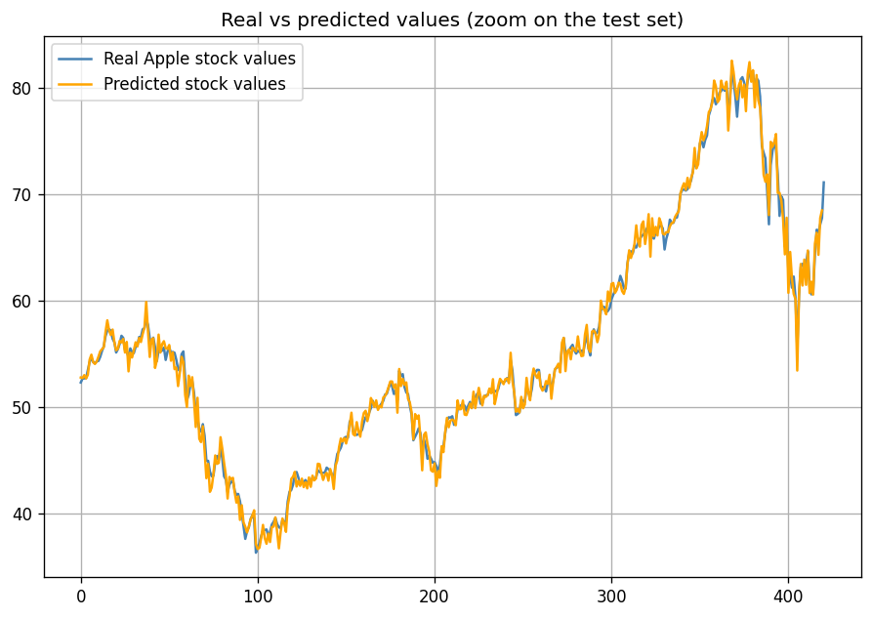
Results

Slide 22
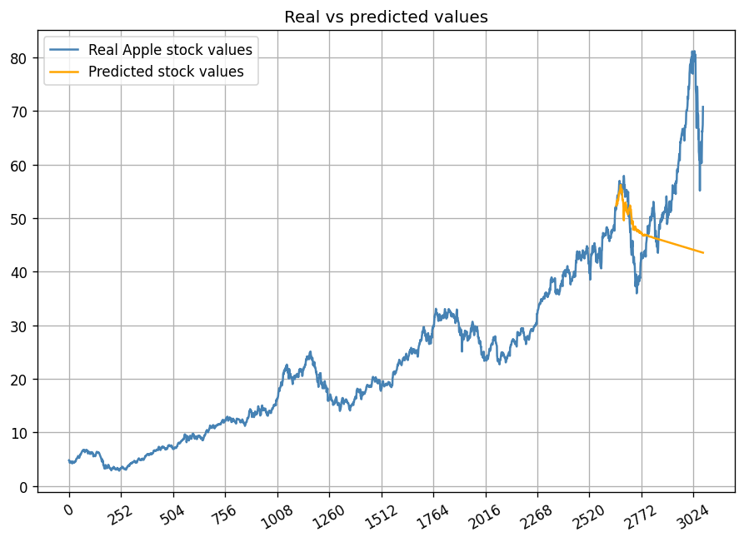
Results

Slide 23
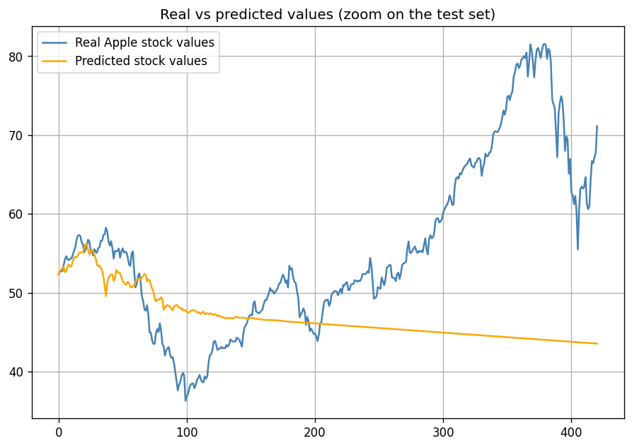
Results

Slide 24
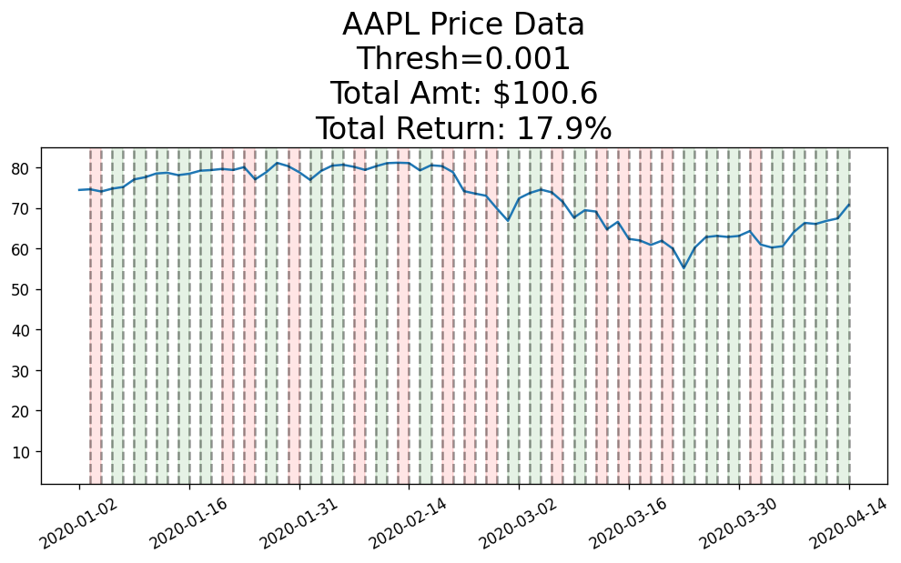
PREDICTION BOT

Slide 25
Prediction & Comparison
ARIMA:
MSE: 0.452
MAE: 0.455
LSTM:
MSE: 0.668
MAE: 0.606

Slide 26
Conclusion
Both models grant a (small) benefit
More complexity needed to increase profits
Adding more features (multivariate forecasting)
Combining models for more precision
Notes:
Pourquoi pas parler des taxes, qui mangeraient les maigres bénéfices réalisés.
Pourquoi pas également parler de faire une prédiction sur plus qu’un jour, histoire de parler d’un cas plus réaliste (mais pas nécessaire)

Slide 27
Questions ?
Links:
Data: https://finance.yahoo.com/quote/AAPL?p=AAPL&.tsrc=fin-srch
Trading BOT: https://github.com/ritvikmath/YouTubeVideoCode/blob/main/ARMA%20Stock%20Forecasting.ipynb
Financial forecasting with ARIMA: https://medium.com/auquan/time-series-analysis-for-finance-arima-models-acb5e39999df
Time series prediction with LSTM in Tensorflow: https://towardsdatascience.com/time-series-prediction-with-lstm-in-tensorflow-42104db39340

